Slide 1


BIG GAME CENSUS
ANALYTICS
BY PREET JITENDRA JAIN

Slide 2

PROJECT DETAILS
Project Title | Big Game Census Analytics
Technology | Data Science
Domain | Sports
Project Difficulty Level | Advanced
Programming Language used | Python
Tools Used | Google Colab, Power BI, Excel, Canva

Slide 3



INTRODUCTION
This Big Game Census data visualization takes a fun look at where Super Bowl 52 players come from, the related population figures, and opens up pathways (via embedded links) to additional census data points.
The dataset came about when two hapless data nerds had their teams eliminated from the playoffs, thus turning to data to try to find more rooting interests for Super Bowl 52. The rosters for both, competing teams are included, with the corresponding roster information and birthplace and state population information. The developers utilized
census data pulled from census.gov, and roster information from Yahoo Sports, and designed the data visualization within the Power BI .

Slide 4
DATASET INFORMATION
Player Name : Count of player's name considered.
Age : average of player's age considered.
Player Birth State : Birth state of the player
Location : Average of latitude of player's birthplace and average of longitude of player's birthplace by their birth state considered.
Weight: Avg. weight of the player is considered.
Position : Position of the the player on field.
Team: Name of the team of which player represents is mentioned.
Population Estimate : Count of population estimates 2016 considered.

Slide 5
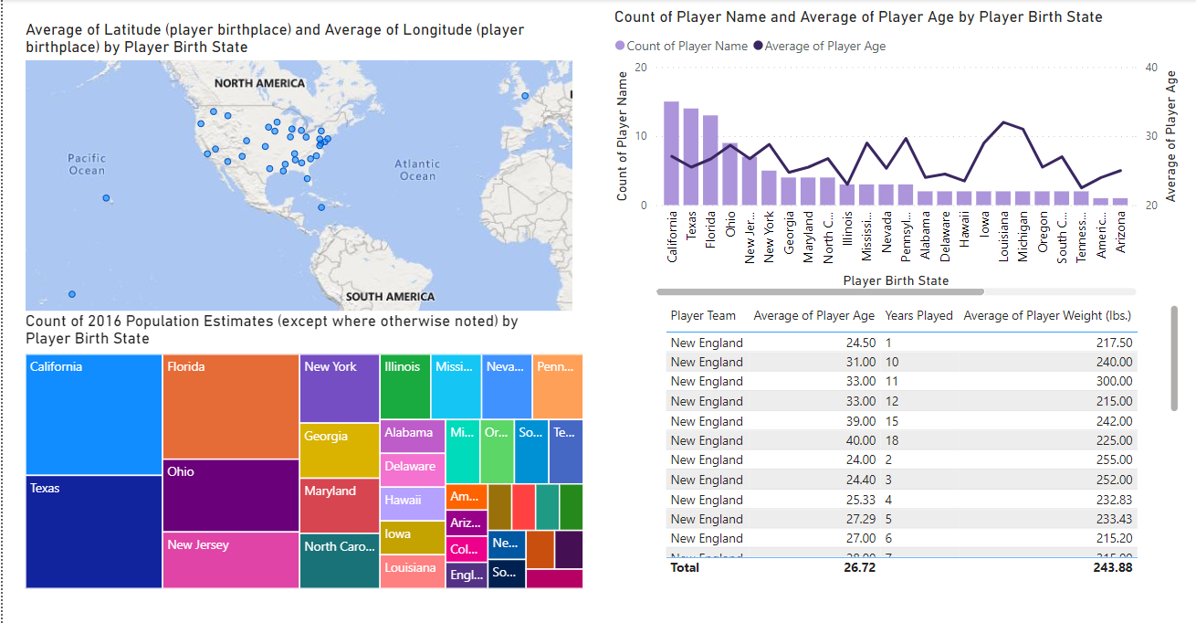

Slide 6
Key Performance Indicator (KPI)
Average of latitude of player's birthplace and average of longitude of player's birthplace by their birth state
Count of player's name and average of player's age by their birth state
Count of particular years of population estimates by player's birthplace
Table/ List of player’s team, age, their average weight and years they played

Slide 7

THANK YOU

Slide 8

INTRODUCTION
This Big Game Census data visualization takes a fun look at where Super Bowl 52 players come from, the related population figures, and opens up pathways (via embedded links) to additional census data points. The dataset came about when two hapless data nerds had their teams eliminated from the playoffs, thus turning to data to try to find more rooting interests for Super Bowl 52. The rosters for both, competing teams are included, with the corresponding roster information and birthplace and state population information. The developers utilized
census data pulled from census.gov, and roster information from Yahoo Sports, and designed the data visualization within the Power BI .

Slide 9
DATASET INFORMATION
Player Name : Count of player's name considered.
Age : average of player's age considered.
Player Birth State : Birth state of the player
Location : Average of latitude of player's birthplace and average of longitude of player's birthplace by their birth state considered.
Weight: Avg. weight of the player is considered.
Position : Position of the the player on field.
Team: Name of the team of which player represents is mentioned.
Population Estimate : Count of population estimates 2016 considered.

Slide 11
Key Performance Indicator (KPI)
Average of latitude of player's birthplace and average of longitude of player's birthplace by their birth state
Count of player's name and average of player's age by their birth state
Count of particular years of population estimates by player's birthplace
Table/ List of player’s team, age, their average weight and years they played

Slide 12

THANK YOU

